Slide 1
How to Write a Screenplay
LEVENT DURANLI
Senior Instructor
lduranli@ciu.edu.tr

Slide 2
SCREENPLAY
What is a Screenplay?
A movie script or screenplay is the printed version for any feature film or TV show.
Scripts includes characters actions, dialogue and movement as well as stage direction.

Slide 3
SCREENPLAY
Script & Shooting Script
Movie script format has a unique set of industry standard rules, which are slightly different than the script writing format used in a shooting script.
A shooting script is a more precisely formatted version of the script, used in Pre-Production and Production to turn the screenplay into a film. This version can include elements like camera directions, music cues or transitions.

Slide 4
SCREENPLAY
How is Important the Format of the Screenplay?
There are basic formatting rules for screenplays that are essential to learn if you hope to get your screenplay produced. It doesn't matter if you have an amazing story, a script that isn't formatted properly immediately jumps out as "unprofessional" to readers, producers, actors, and anyone that is accustomed to reading scripts as part of their profession. Getting a screenplay produced is tough enough without putting yourself at a disadvantage with an incorrectly formatted screenplay.

Slide 5
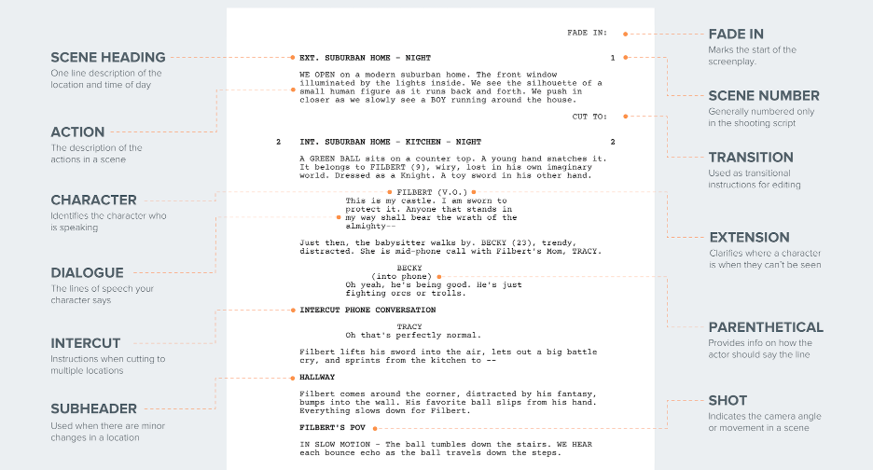
SCREENPLAY
Screenplay Format

Slide 6
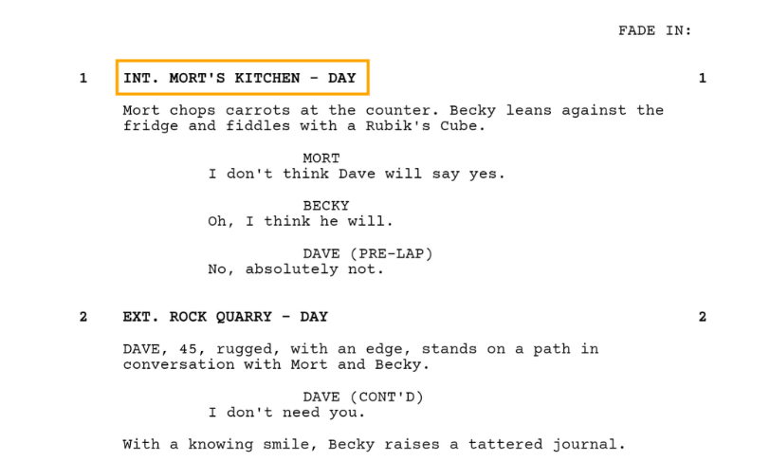
SCREENPLAY
Screenplay Format
Sluglines
Sluglines (also known as scene headings) tell the reader where the action is happening. It’s a location, followed by a time, and looks something like this.

Slide 7
SCREENPLAY
Screenplay Format
Sluglines
In this screenplay example, you'll see that Scene 1 starts in Mort's Kitchen but what does INT mean in a script? When it comes to sluglines, you first have to establish whether the scene takes place inside (INT.) or outside (EXT.)
Then add the location of the scene, followed by the time of day (Day, Night, Morning, Evening, etc.).

Slide 8
SCREENPLAY
Screenplay Format
Sluglines
When a scene directly continues from the previous scene, mark it “continuous” in the time slot. If it's a couple minutes later, feel free to use "moments later" in your slugline.
Be sure to put the entire slugline in ALL CAPS.

Slide 9
SCREENPLAY
Screenplay Format
Sluglines
Sluglines are important because they are how your assistant directors and line producers will plan out how things get shot.
The difference between one scene being night and the next being day is important to continuity for hair, makeup, and wardrobe departments.
That's why this is one of the most essential elements in movie script format — it tells you when and where a scene is taking place in the grand scheme of the script. Knowing the time of day and where the scene takes place affects nearly every department in a major way.

Slide 10
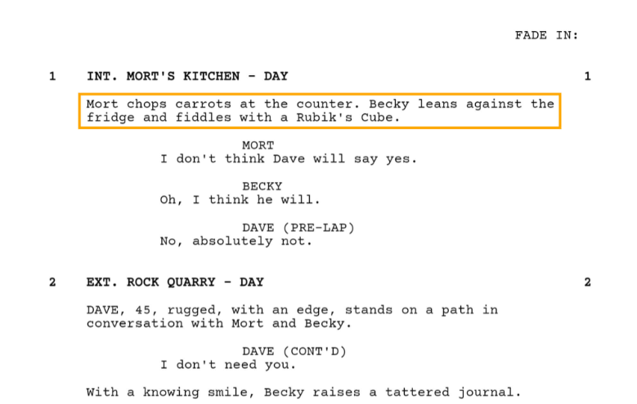
SCREENPLAY
Screenplay Format
Action Lines
Action lines go right beneath the slugline. Proper screenplay format dictates that they always be written in the present tense and as visually descriptive as possible.

Slide 11
SCREENPLAY
Screenplay Format
Action Lines
This is where you create the images of the film in the reader's head. Action lines should only describe what an audience can see or hear. They should be short and concise, easy to visualize, and should move the characters, and plot forward. Action lines should always be written in the present tense.
Only Write What the Audience Can See or Hear!

Slide 12

SCREENPLAY
Screenplay Format
Action Lines
Since the audience will not be able to see that Frank wished he had a time machine based on how it is written above, you will need to revise this so the audience can hear that he wished he had a time machine through a voice over (designated as V.O. for voiceover and further described in the parentheticals section).

Slide 13
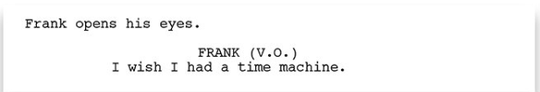
SCREENPLAY
Screenplay Format
Action Lines
Now the audience will know that Frank wished he had a time machine through his voice over. Keeping this rule in mind when writing will make it very easy for the reader to visualize the film in their heads.

Slide 14
SCREENPLAY
Screenplay Format
Action Lines
When describing the shot or introducing a character through your action lines, try not to exceed 4 action lines per paragraph for the sake of the reader.
This rule varies slightly, but most are in agreement that the shorter the better.

Slide 15
SCREENPLAY
Screenplay Format
Character Cues
After the action/description, when a character speaks, we start with their name. You center and capitalize a character ID and put dialogue underneath.

Slide 16
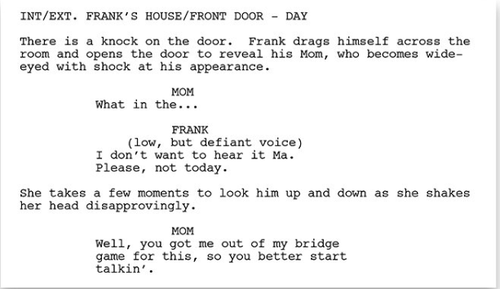
SCREENPLAY
Screenplay Format
Dialogue
When your characters speak, it is called dialogue and it is written in a specific way. First, you need to write the name of the character speaking in ALL CAPS approximately 3.5" from the left margin.

Slide 17
SCREENPLAY
Screenplay Format
Dialogue
The dialogue is then inserted as a single space below approximately 2.5" from the left margin. Never center the dialogue on the page! It should always be left justified at the approximate margins listed above.

Slide 18
SCREENPLAY
Screenplay Format
Dialogue
If there is more than one character speaking in the scene, you will need to identify each speaking character every time they speak. Speaking characters are double spaced.

Slide 19
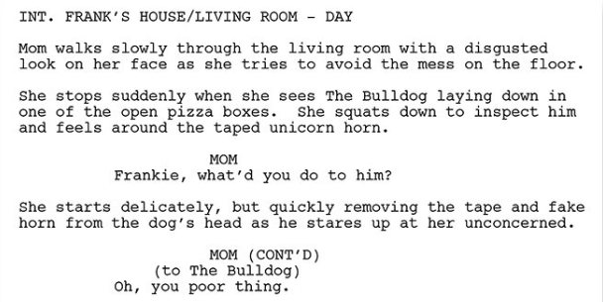
SCREENPLAY
Screenplay Format
Dialogue - Extensions
If the same character speaks through an action, you need to write (CONT'D) next to the character's name after the line of action. For example:

Slide 20
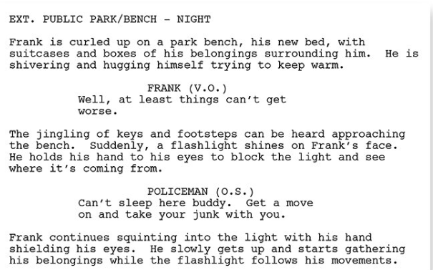
SCREENPLAY
Screenplay Format
Dialogue - Extensions
When a character is speaking in a scene but is not physically in the scene or not physically speaking in the scene, you need to designate the dialogue as either voice-over (V.O.) or off-screen (O.S.) which is placed on the same line as the speaking character's name in the dialogue.

Slide 21
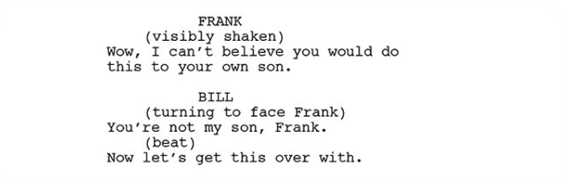
SCREENPLAY
Screenplay Format
Parentheticals
Parentheticals are direction for the actors and are placed beneath the speaking character's name in the dialogue to express the actor's emotions or actions. As with any direction in a spec script, it should be minimal, so make sure to use parentheticals only when necessary. When you need to represent a brief pause in the character's speech, you should use the parenthetical (beat) between the lines of dialogue.

Slide 22
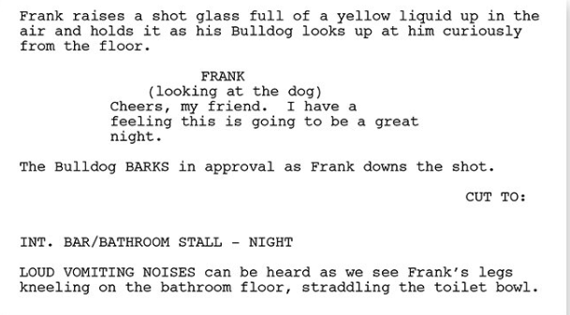
SCREENPLAY
Screenplay Format
Transitions
Direction for how one shot transitions in the next shot in your screenplay is called a transition. All transitions are double spaced and are approximately 6.0" from the left margin. Popular transitions also include "DISSOLVE TO:" and "CUT TO:" For example:

Slide 23
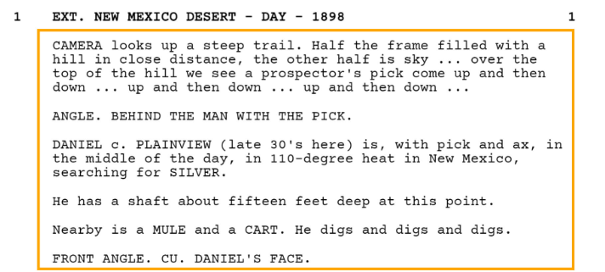
SCREENPLAY
Screenplay Format
Shots
Formatted like a caps-locked action line, shots direct our attention to a specific visual or way of seeing something. This can include various camera shots, camera angles or camera movements.

Slide 24
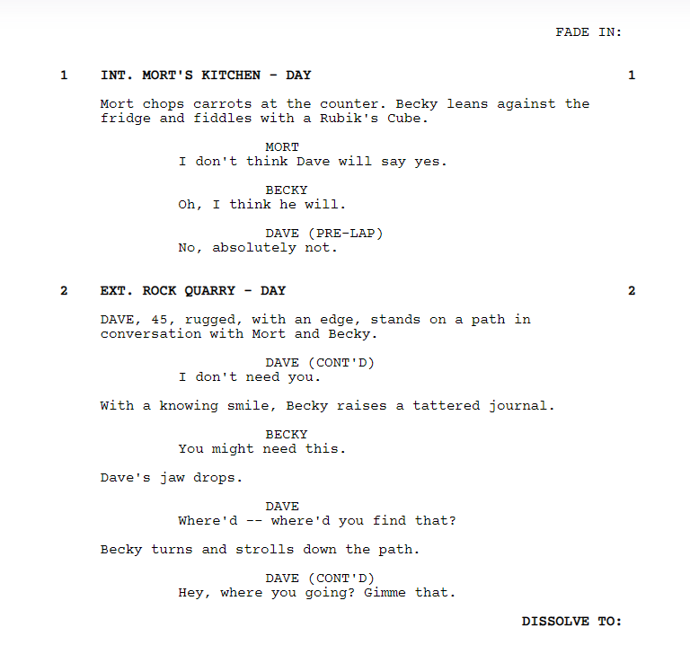
SCREENPLAY
Screenplay Format
Examples

Slide 25
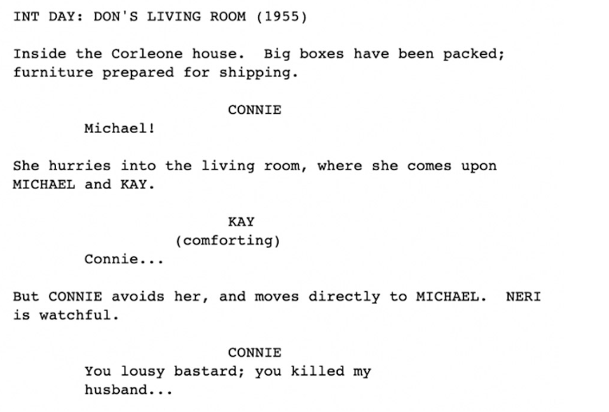
SCREENPLAY
Screenplay Format
Examples

Slide 26
SCREENPLAY
Thanks for Watching

Slide 27
SCREENPLAY
REFERENCES
McKee.R, (1997), Story: Substance, Structure, Style and the Principles of Screenwriting, New York:Regan Books

